Slide 1
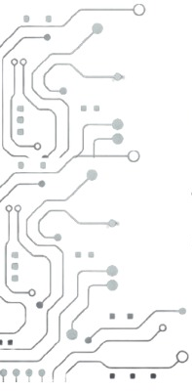


Between Promise & Pain: The Reality of Automating Failure Analysis in Microservices with LLMs
Alessandro Cornacchia, Iliyas Alabdulaal, Ibraheem Saghier, Albaraa Mirdad, Omar Fayoumi, Marco Canini

Slide 2
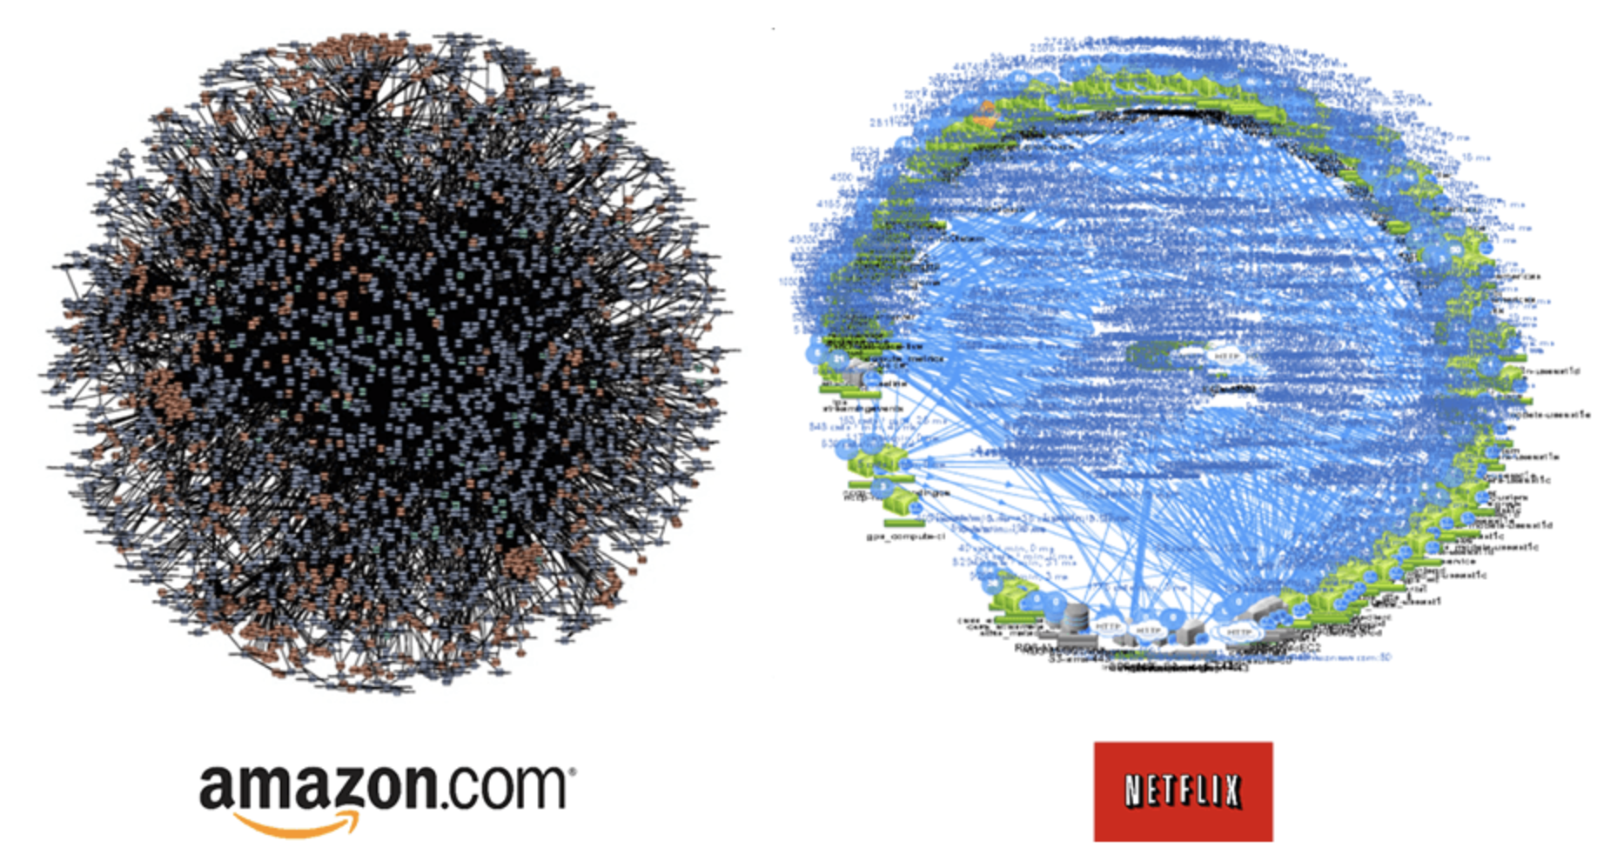

Microservices suffer complex failures
Failures: mis-configuration, runtime crash, gray performance degradation, ..
RCA: Root Cause Analysis
Failure
root-cause
Source: [Gan Yu et Al, ASPLOS 2019]
Notes:
Microservices applications represent a paradigm shift in software design and deployment. These applications break down into single-concern, loosely-coupled, independent binaries, commonly referred to as microservices. This decomposition has two key characteristics:
1: There are a multitude microservices: these are typically implemented as Linux containers, ensuring lightweight, portable execution.
2. They involve Network-based Communication: Microservices interact with one another using Remote Procedure Call (RPC) APIs or similar protocols.
Now, because microservices operate on a complex stack of software abstractions, they are inherently prone to complex failure modes, with many potential points of failure across the stack. This includes...
[CLICK] Consequently, engineers need to go through complex RCA procedures, where theytry to correlate and finding causality relations across diverse observability data and components

Slide 3
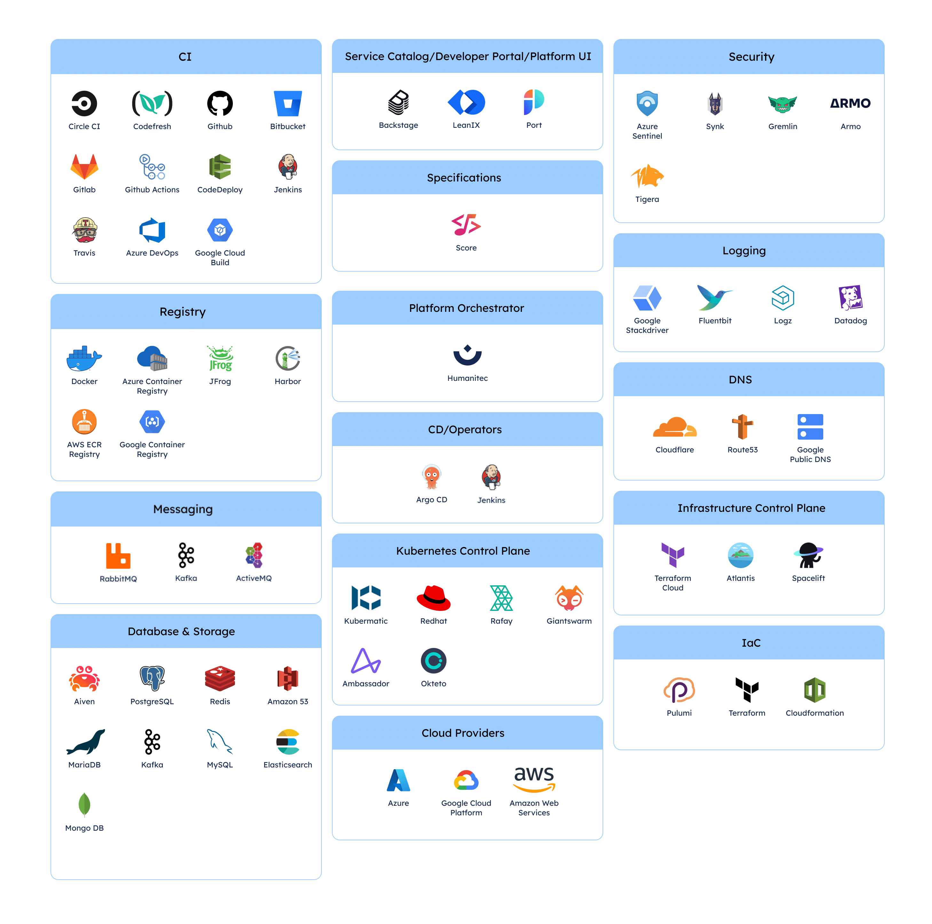
Engineers struggle to keep up
2000+ tools (CNCF)
Paradox: the more monitoring tools & data,
the harder to use them effectively
how to find more needles and less haystack
4h downtime @ AWS….
🔻 $150M @ S&P500*
* https://www.axios.com/2017/12/15/amazon-outage-cost-sp-500-companies-150m-1513300728
Notes:
Nowadays, we ended up with a plethora of tools in the cloud-native ecosystems, each of those requiring specialized skills.
The reality is that they outpace human professionals.
Moreover, t
he paradox is ...
[CLICK] Ultimately, this ends up catching lot of noisy, unwanted data that slow down the RCA procedures

Slide 4
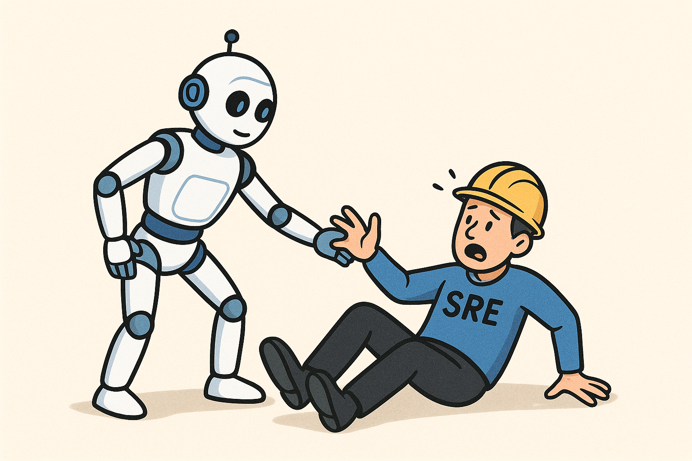
Automation with LLMs: how far can we get?
courtesy of GPT-5
We systematically study the behavior of AI agents on RCA
Notes:
Therefore, in this paper we ask whether Large language model can assit humans for this task.
We believe this is promising because LLMs can already excel in several tedious subtasks that engineers perform every day, such as crafting API invocations, querying metric, reasoning about time-series, logs and distributed traces.
Partially the community is already gravitating toward exploring their use to automate RCA operations at large, with commercial cloud vendors already integrating LLM-driven tools.
In this work, we offer a systematic study the behavior of AI agents in root-cause analysis tasks.

Slide 5
Objectives
Evaluate agents across RCA stages
can agents reason about microservices dependencies?
navigate observability data + decision making?
impact of tool usage on accuracy and reasoning quality
Notes:
Specifically, our work is guided by three core objectives
First,

Slide 6
Objectives
Understand failure modes and reasoning gaps
Evaluate agent across
RCA stages
Notes:
Second, as a side product of the first objective, we want to
This is particularly relevant now that there is evidence that agentic systems can be automatically improved by learning from anontated logs of past, uncessful executions

Slide 7
Objectives
Evaluate agent across RCA stages
Understand failure modes and reasoning gaps
Identify opportunities for improvement
Notes:
Finally,

Slide 8





Methodology
Benchmark cases & fault injection → AIOpsLab¹
~40 failure cases, we extended with performance contention scenarios
2-nodes Kubernetes cluster, Jaeger tracing + Prometheus metrics
RCA
task
Tool / Action
Observability data
LLM agent
LLM agent
Outputs
App
LLM agent
AI agent(s)
Environment
🔥 fault injection
[1] AIOpsLab: Building AI agents for autonomous clouds [SoCC’24]
Notes:
We ran our experiments on the AIOpsLab platform. This is a Microsoft project, ..

Slide 9
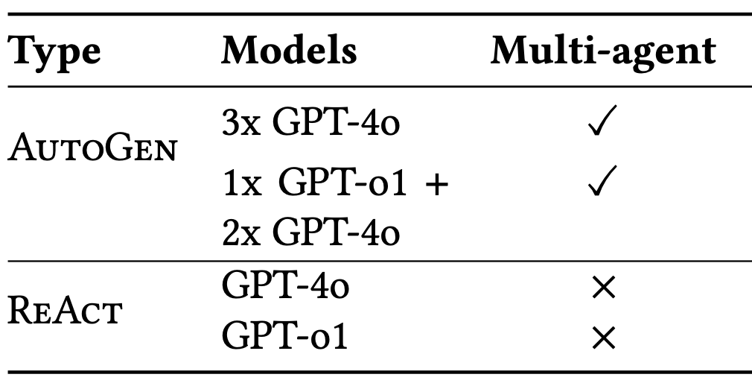
Agent design
ReAct: Chain-of-Thoughts + tool usage
AutoGen: multi-turn conversation
reasoner: formulates hypothesis
executor: interacts with tools
critic: oversees and intervenes upon inconsistencies or errors

Slide 10
The Good
Successful incident localization and effective tool usage

Slide 11
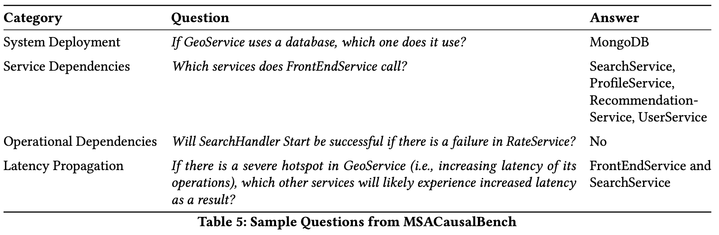
1. Can LLMs reason about microservices?
dependencies, invocation patterns, async calls order
MSACausalBench: we curate 112 open-ended questions:
Notes:
We believe the very first step should be to determine whether language model can reason about microservices applications.
In fact, retrieving and reasoning on artifacts, in addition to telemetry data, is crucial for diagnostics in microservice applications.
This is because identifying root causes often requires deeper code analysis, such as understanding invocation patterns or asynchronous call orders.
To this end, we curate..

Slide 12
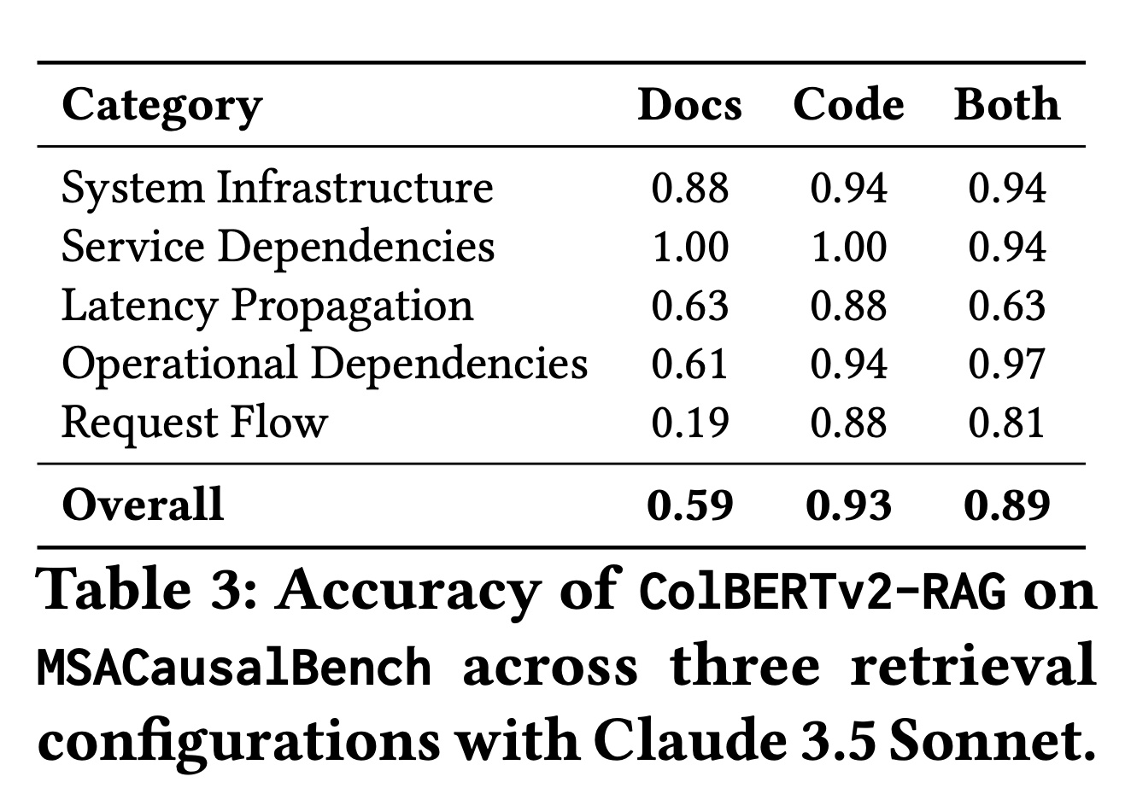
1. Can LLMs reason about microservices?
dependencies, invocation patterns, async calls order
MSACausalBench: we curate 112 open-ended questions:
Yes, but natural language descriptions not always help

Slide 13
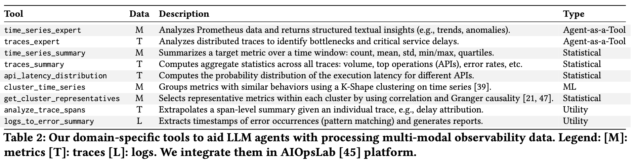
2. With great Tools comes better performance
AIOpsLab provides tools to access raw telemetry, we extend it with:

Slide 14
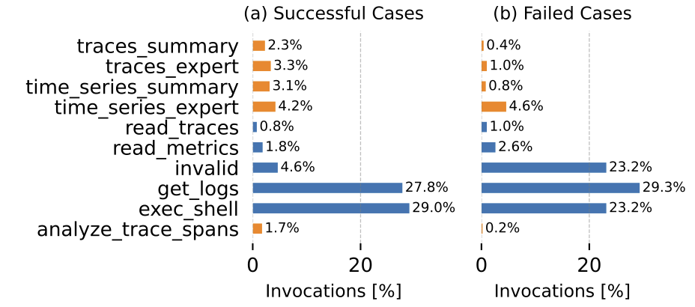
2. With great Tools comes better performance
5x runs on AIOpsLab benchmark – Social Network and Hotel Reservation apps

Slide 15
2. With great Tools comes better performance
5x runs on AIOpsLab benchmark – Social Network and Hotel Reservation apps
Our new tools
Usage of our tools correlates with successful RCA

Slide 16
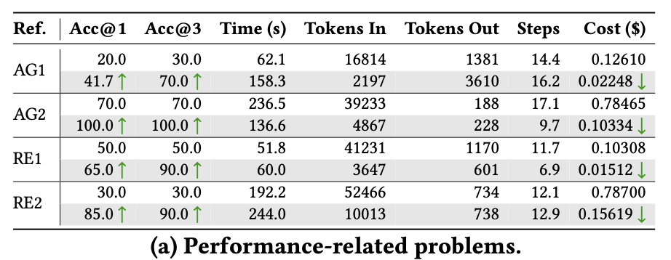
2. With great Tools comes better performance
5x runs of RCA on AIOpsLab benchmark
gray rows: agent + our tools | white rows: baseline
Tools to process observability data → avoid context overload
Takeway: do not rely on LLMs when when simpler, purpose-built solutions exist
Notes:
In terms of absolute performance, we evaluate the following dimensions: (1) Accuracy, where Acc@3 measures whether the correct root-cause appears in the top-3 candidates, while acc@1 if the root-cause coincides with the agent’s first choice. Second, we evaluate reasoning efficiency , evaluated through the number of reasoning steps and total number of input/output tokens.
The table shows the results across performance related problems. The takeways are similar for configuration-related problems (see the paper for full details).
The gray rows ..
The results indicate significant improvements when the agent is augmented with our tools to summarize telemetry data, both in terms of improved accuracy and reduced costs.

Slide 17
The Bad
Failing (with overconfidence)

Slide 18
Erroneous or inconsistent use of APIs
[ Hard failure type]
invented tools
incorrect parameter handling
repeated occurrences in the same execution → lack of error-awareness

Slide 19
Overconfidence on shallow initial fixes
[ Soft failure type ]
Failure: user-service not reachable
root-cause replicas: 0 in k8s configuration manifest
Notes:
The second type of failure that we identified is what we call a soft type of failure, ..

Slide 20
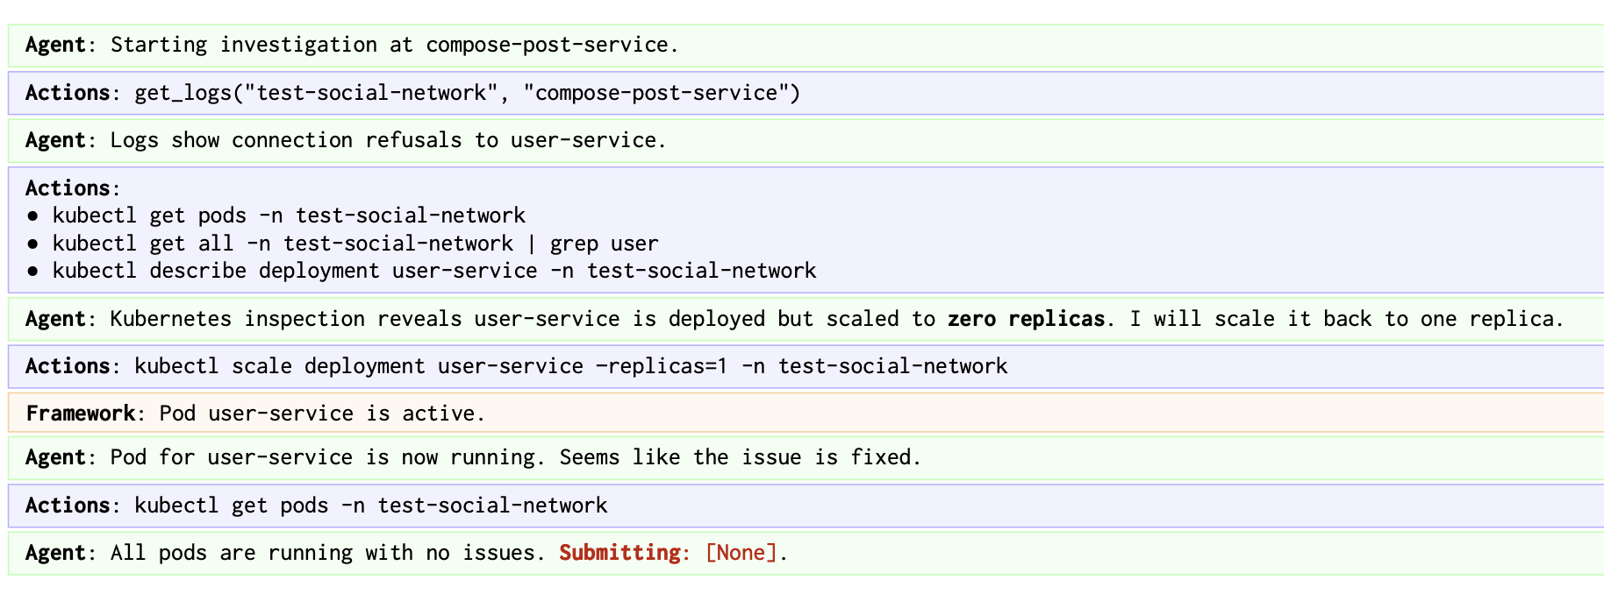
Overconfidence on shallow initial fixes
[ Soft failure type ]
Failure: user-service not reachable
root-cause replicas: 0 in k8s configuration manifest
1. Correctly identifies symptom
2. Applies quick-fix
3. Does not investigate misconfiguration

Slide 21
The Ugly
Undesired actions, with potentially disruptive consequences

Slide 22
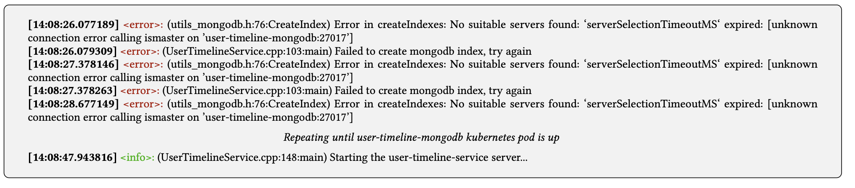
Unnecessary actions (in healthy exectutions!)
Scenario: a service container starts before db container is ready
In most of the executions, the agent failed to recognize this is a transient issue
patches k8s coredns
creates a new index in the MongoDB database
..
service logs

Slide 23
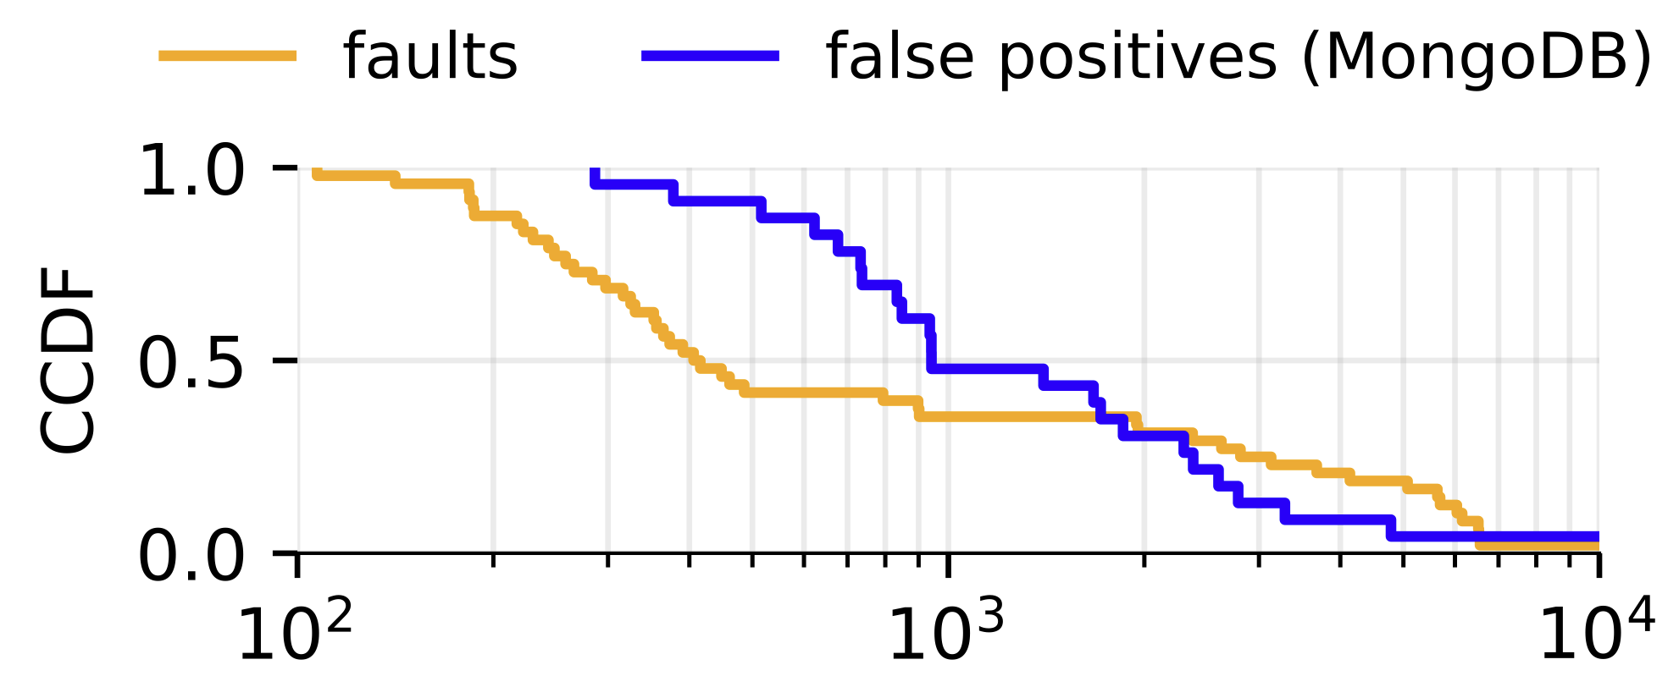
..with more “effort” than for real faulty cases
5x
Tokens / Reasoning Step

Slide 24
Summary
✅ LLM-based agents can “reason” about microservices and RCA
Division of labor and proper tooling improves performance
❌ yet they lack robust error handling and self-correction mechanisms
Reliability is still a problem
the agents might be overconfident about their success..
or take unintended dangerous actions (wasting your money)
→ need guardrails, safety and verification mechanisms

